Slide 1


HELP ME……..!!!!!

Slide 2
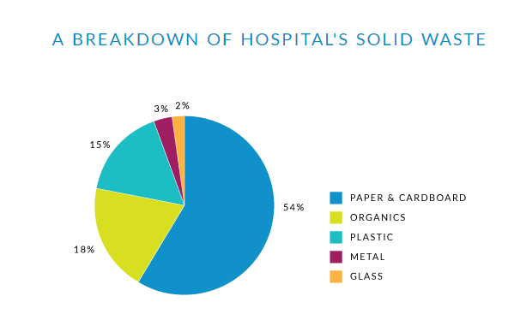
What’s the problem?
Two billion pounds of paper waste is generated each year by hospitals.

Slide 3


Slide 4
Hospital Staff Module
Patient appointment and billing.
Doctors schedule.
Room reservation and many others.

Slide 5
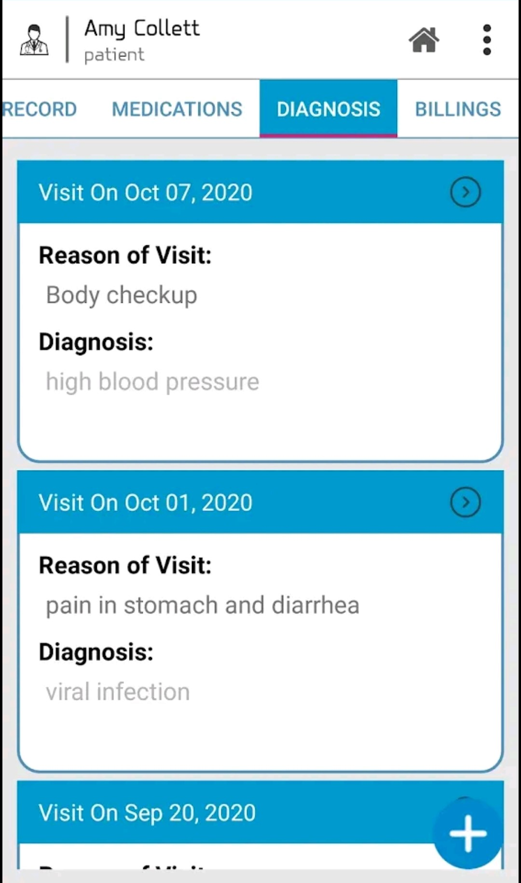
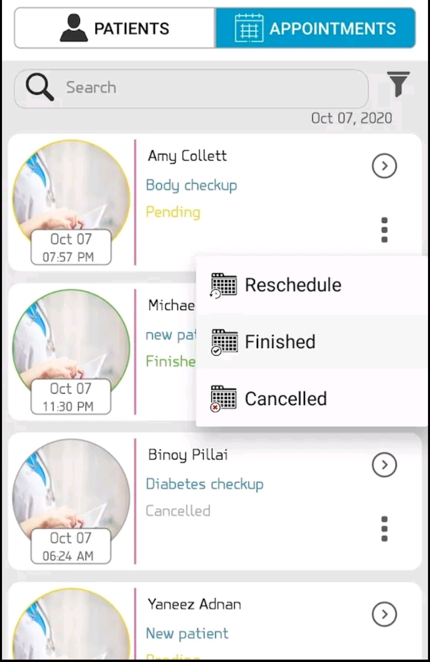
Patient details
Appointment list

Slide 6
Doctor’s Module
List of patients with all details.
Appointment schedule
Schedule of surgeries and all others.

Slide 7
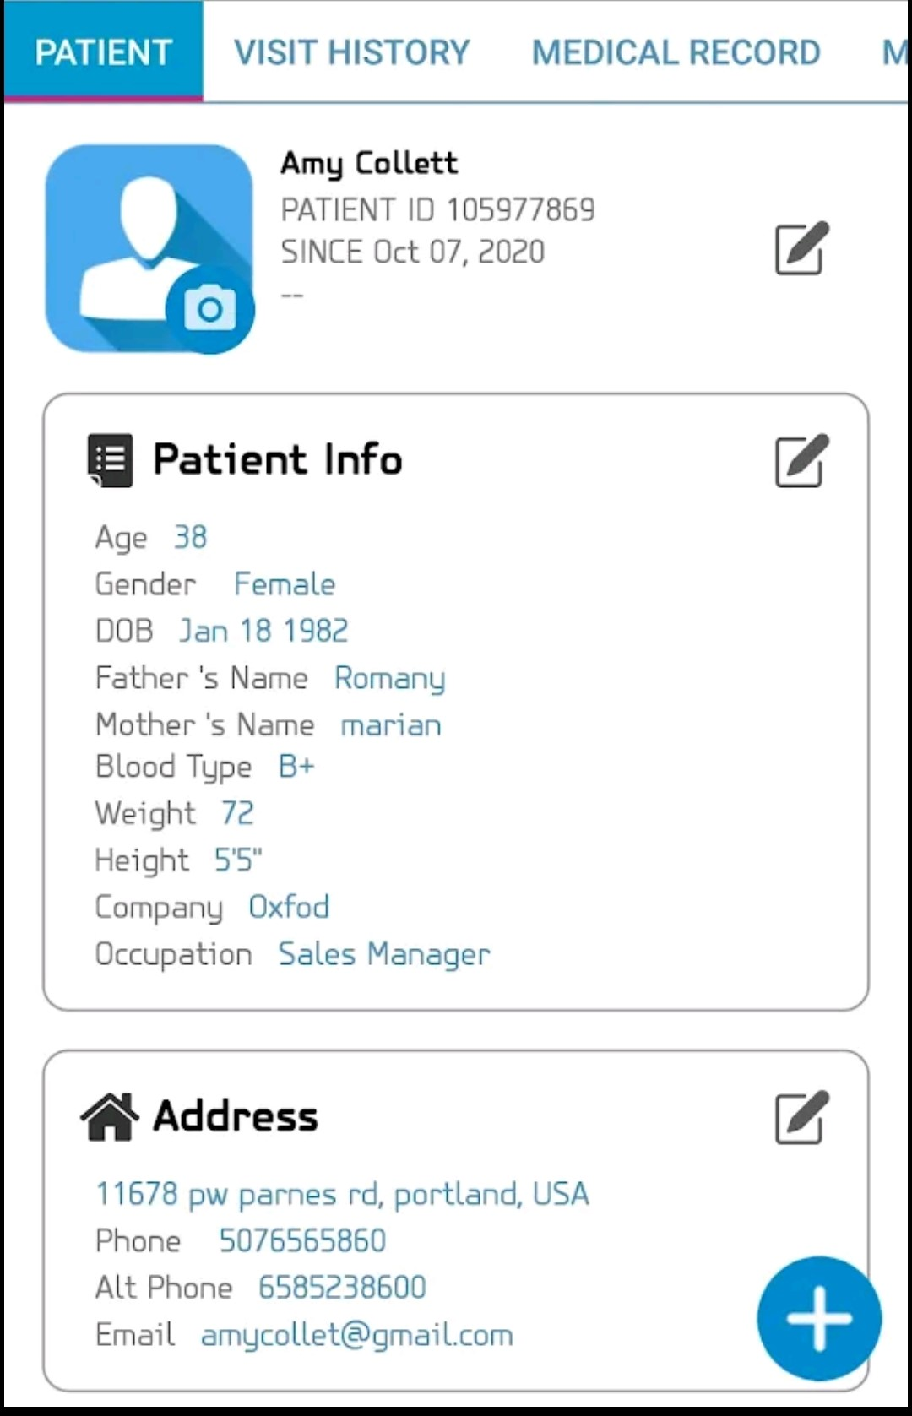
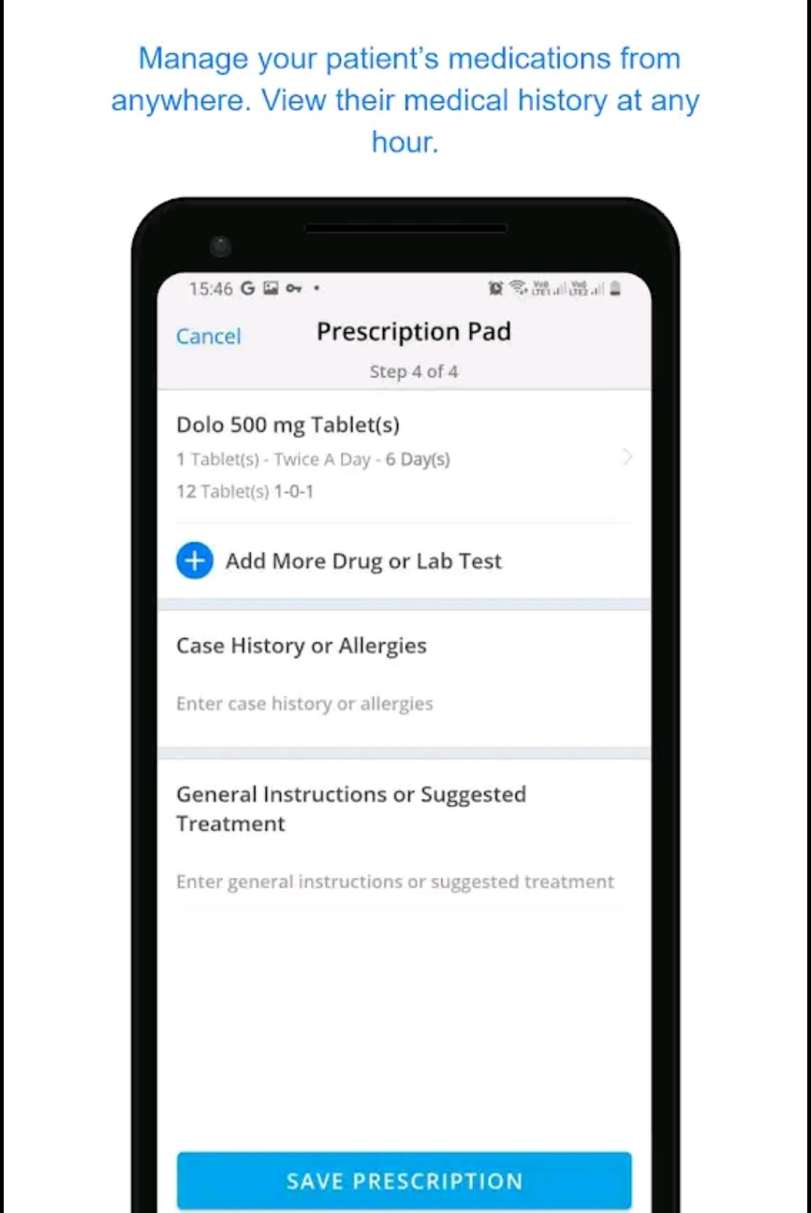
Prescription to update medication
Patient details

Slide 8
PATIENT’s Module
Contact details of pharmacy and Doctors
Medical History
Medicine details
Billing and Insurances

Slide 9
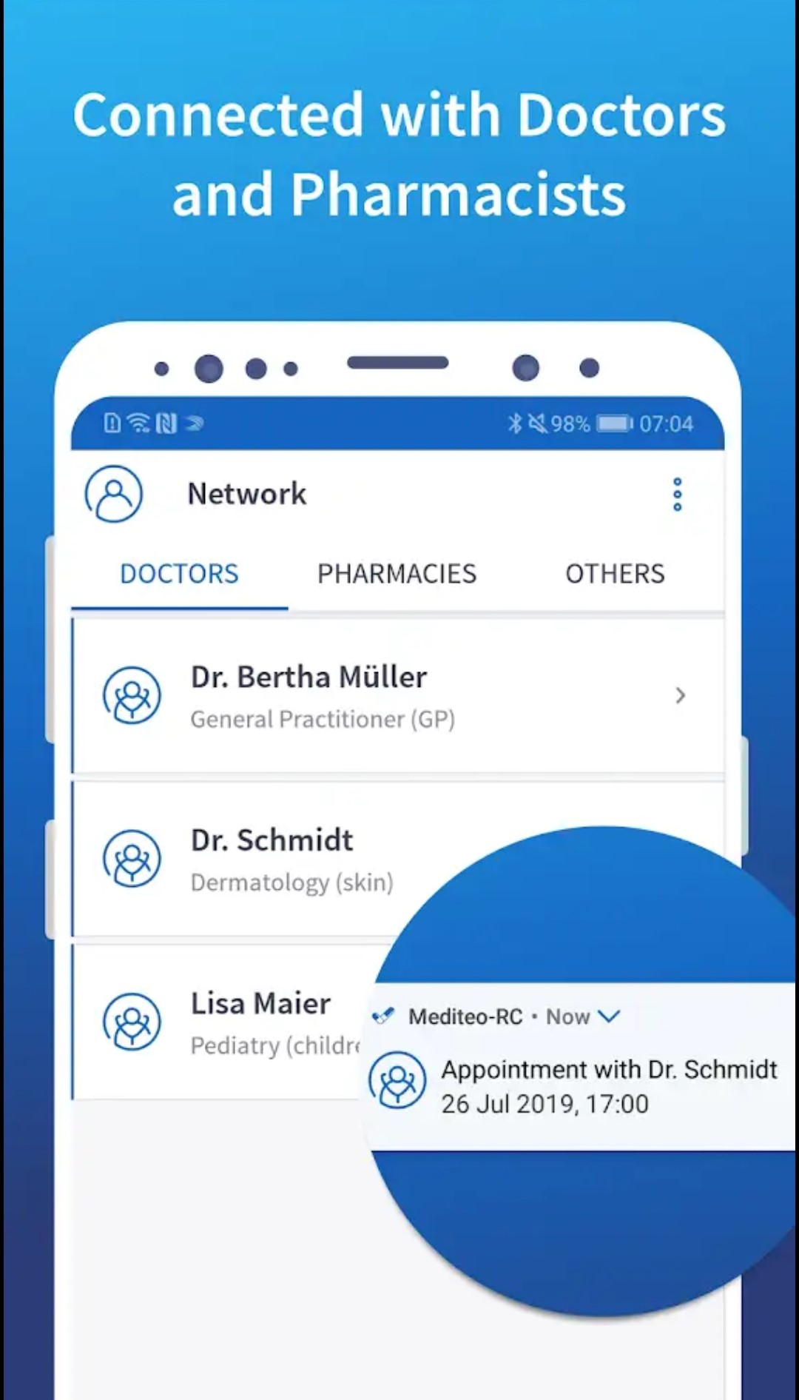
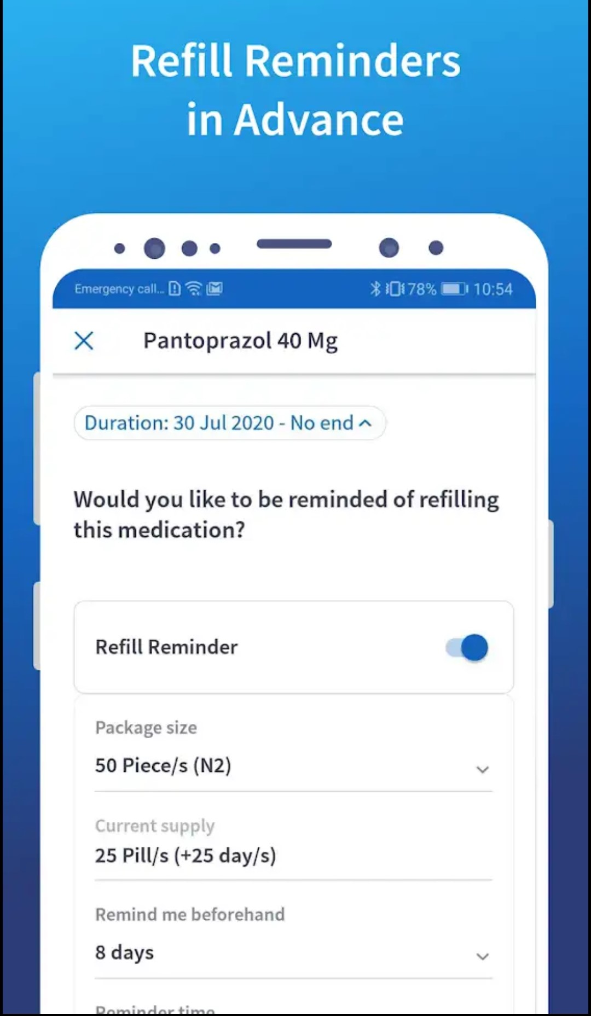

Slide 10
BUSINESS MODEL
CUSTOMER SEGMENTS
Hospitals
Medical and Pharmaceutical companies
KEY PARTNERS
Payment partners
E-commerce and Outsourcing Partners

Slide 11
MARKET VALIDATION
FINANCES AND REVENUE
2100
1100
500
400
Each Software Value
€5300
Yearly
Subscription
€600
Monthly
Subscription
€400
Extra Services
€200
€ 2M

Slide 12
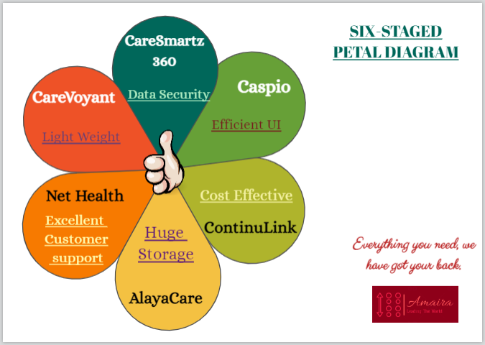
WHY ARE WE BETTER?

Slide 13





MY TEAM
_{Development}
Client Management
Finance Management
Ariba Marium
Sanjula Singh
Aiman Alam
Shree Ranjan
Sonal Gupta

Slide 14

Thank You For Your Time And Patience…!
Any Questions

